Slide 1
Anomaly Detection Techniques

Slide 2
Simple Statistical Methods
statistical properties of a distribution
including mean, median, mode, and quantiles
rolling window to compute the average across the data points
to smooth short-term fluctuations and highlight long-term ones.
low pass filter／ Kalman filter

Slide 3
Machine Learning-Based Approaches
Density-Based Anomaly Detection
K-nearest neighbor
Local outlier detection reconsidered(paper)
Clustering-Based Anomaly Detection
Support Vector Machine-Based Anomaly Detection
robust estimator of covariance
One-Class SVM
Isolation Forest(paper)

Slide 4
Machine Learning-Based Approaches
Density-Based Anomaly Detection
K-nearest neighbor
Local outlier detection reconsidered(paper)
Clustering-Based Anomaly Detection
Support Vector Machine-Based Anomaly Detection
robust estimator of covariance
One-Class SVM
Isolation Forest(paper)

Slide 5
参考
https://www.datascience.com/blog/intro-to-anomaly-detection-learn-data-science-tutorials
http://scikit-learn.org/stable/modules/outlier_detection.html#outlier-detection

Slide 6
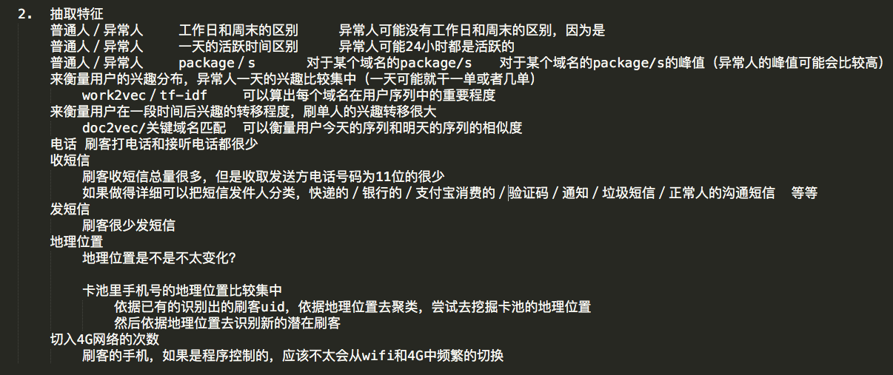
如何抽取特征-刷客

Slide 7
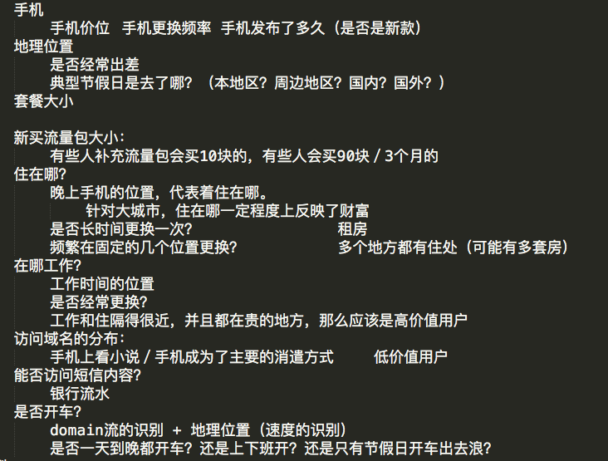
如何抽取特征-低信用客户

